Slide 1
BUAN 6340.003 – Programming for Data Science Project Presentation
TED Talks Data Exploration and Analysis
Prepared By:
Gaurav Bobade (gxb170930)

Slide 2
TED Talks Data Exploration and Analysis:
About Dataset:
The data was originally shared under the Creative Commons License (just like the TED Talks) and hosted on Kaggle.
I have used the ‘ted_main’ dataset to explore the world of TED Talks, who are the speakers, their occupation, views and comments etc.
Dataset File description:
TED_Main Dataset – Dataset size is 2551 rows and 17 columns.
Contains all the information about the talks organized at TED and TEDx events until 21st Sept 2017.

Slide 3
Libraries used and loading the dataset:
Libraries used:
Numpy
Pandas
Matplotlib
Datetime
Seaborn
Sklearn
Loading the ted_main dataset
df= pd.read_csv('D:\\Spring18\\DataScienceforPython\\Project\\TEDTalksDataset\\ted_main.csv’)
df.columns (Columns are the fields which are explained in the next slide)

Slide 4
Fields Description:
name: The official name of the TED Talk. Includes the title and the speaker.
title: The title of the talk
description: A blurb of what the talk is about.
main_speaker: The first named speaker of the talk.
speaker_occupation: The occupation of the main speaker.
num_speaker: The number of speakers in the talk.
duration: The duration of the talk in seconds.
event: The TED/TEDx event where the talk took place.
film_date: The Unix timestamp of the filming.
published_date: The Unix timestamp for the publication of the talk on TED.com
comments: The number of first level comments made on the talk.
tags: The themes associated with the talk.
languages: The number of languages in which the talk is available.
ratings: A stringified dictionary of the various ratings given to the talk (inspiring, fascinating, jaw dropping, etc.)
related_talks: A list of dictionaries of recommended talks to watch next.
url: The URL of the talk.
views: The number of views on the talk.

Slide 5
Data Exploration:
As the first step I explored every column of the dataset and few of them which I have used for clustering and visualization are as follows:
df['views'].describe()
df['comments'].describe()
df['ratings'].describe()
df['duration'].describe()
df['languages'].describe()
Converted unix timestamps to human readable format
df['film_date'] = df['film_date'].apply(lambda x: datetime.datetime.fromtimestamp( int(x)).strftime('%d-%m-%Y'))
df['published_date'] = df['published_date'].apply(lambda x: datetime.datetime.fromtimestamp( int(x)).strftime('%d-%m-%Y'))

Slide 6
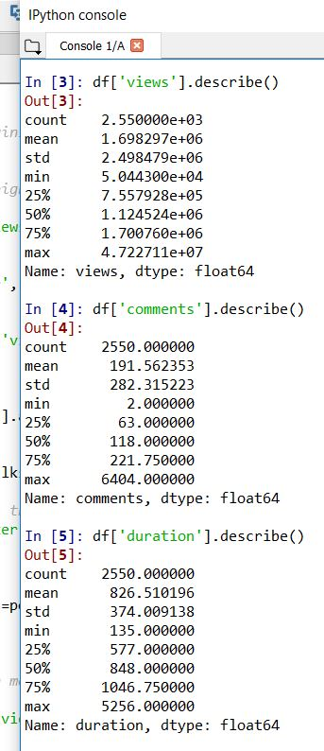
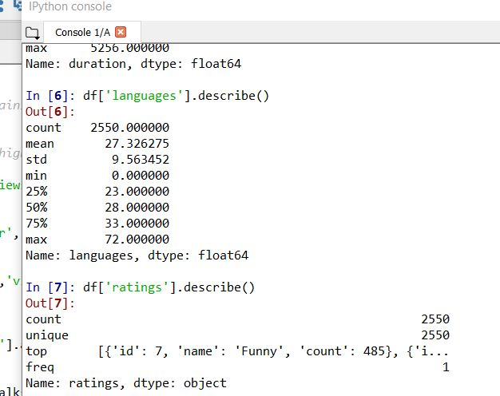
Screenshots for data exploration: describe function gives us summary statistics and the distribution of the fields in TED Talks dataset.

Slide 7
Most Popular, Least Popular TED Talks:
Most Popular:
pop_talks = df[['title', 'main_speaker', 'views', 'film_date','languages']].sort_values('views', ascending=False)[:15]
pop_talks
Least Popular
least_pop_talks = df[['title', 'main_speaker', 'views', 'film_date']].sort_values('views', ascending=True)[:15]
least_pop_talks
Highest Comments
most_comments = df[['title', 'main_speaker','film_date','event','speaker_occupation','comments']].sort_values('comments', ascending =False)[:10]
most_comments

Slide 8
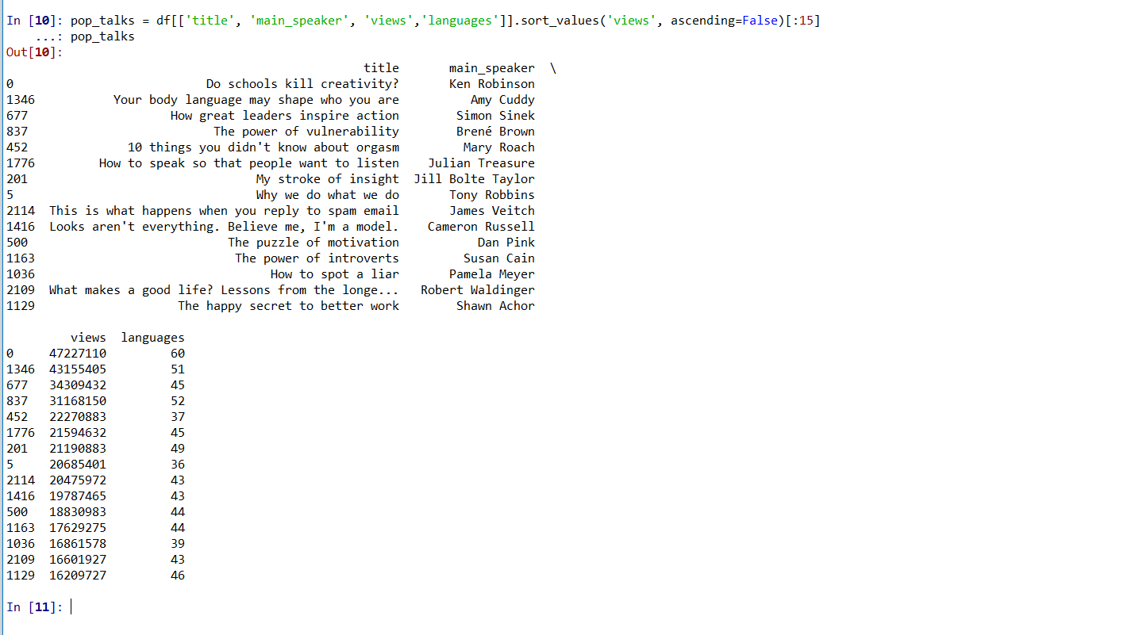
Most Popular, Least Popular TED Talks:

Slide 9
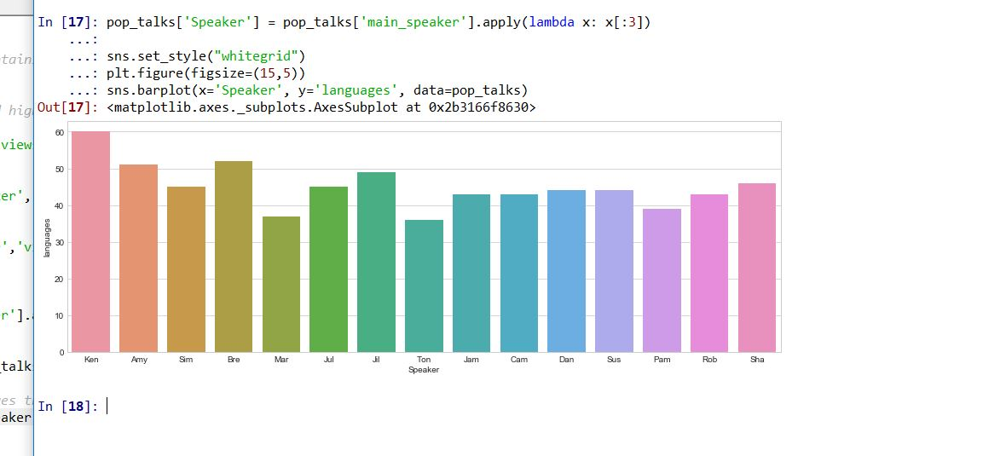
Visualization for TED Talk which is translated in maximum number of languages:
The screenshot below gives and visualization of 15 speakers whose TED Talk is translated in maximum languages.
From the most popular TED Talks we get an idea that Ken Robinson’s TED Talks is most popular with 47 million views.
Other visualizations which I created are 15 most popular TED Talk by views, 15 speakers who TED

Slide 10
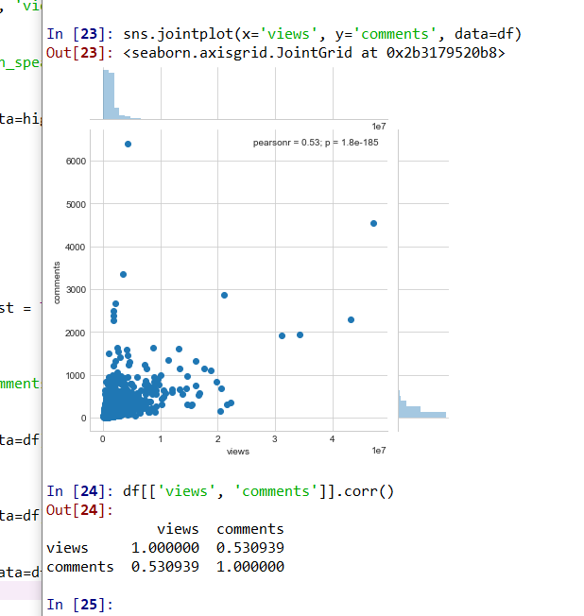
Correlation of fields:
TED Talks get hundred’s of comments and millions of views. Hence, I decided to check if their exists any correlation.
In the screenshot on the right, the pearson coefficient is slightly more than 0.5. This suggests us that medium correlation exists between the two quantities.
Other correlation tried are “views and duration” and “languages and views” and they have less than medium correlation among the quantities

Slide 11
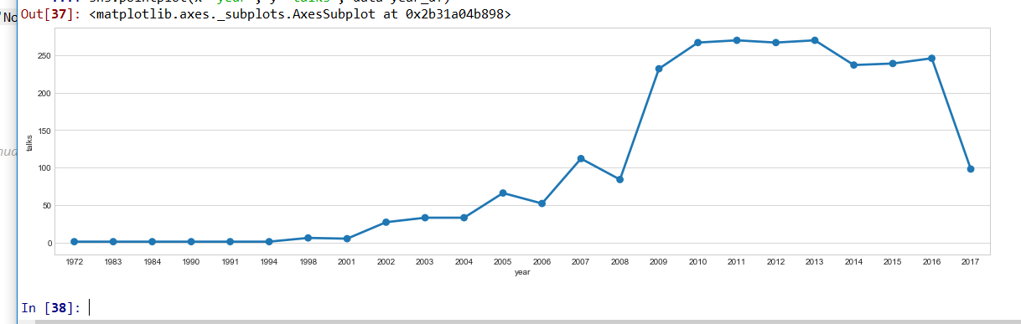
TED Talks Over the years
In 2017 there is a dip in the number of TED Talks the reason can be the data which we have.
The dataset has data until 21st Sept 2017. So it can happen that the number of Talks may increase by the end of 2017.

Slide 12
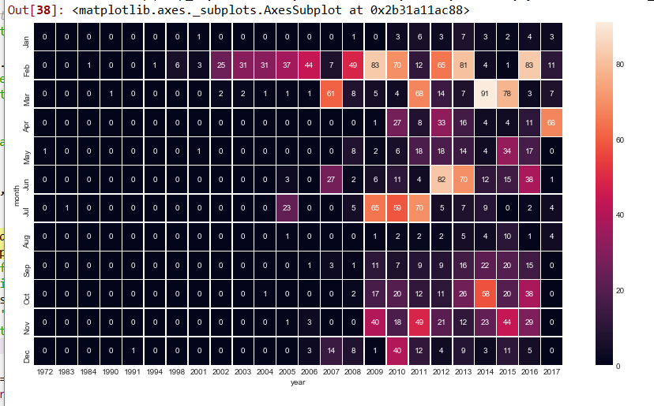
Heat Map giving the summary of TED Talks:
hmap_df = df.copy()
hmap_df['film_date'] = hmap_df['film_date'].apply(lambda x: month_order[int(x.split('-')[1]) - 1] + " " + str(x.split('-')[2]))
hmap_df = pd.pivot_table(hmap_df[['film_date', 'title']], index='film_date', aggfunc='count').reset_index()
hmap_df['month'] = hmap_df['film_date'].apply(lambda x: months[x.split()[0]])
hmap_df['year'] = hmap_df['film_date'].apply(lambda x: x.split()[1])
hmap_df = hmap_df.sort_values(['year', 'month'])
hmap_df = hmap_df[['month', 'year', 'title']]
hmap_df = hmap_df.pivot('month', 'year', 'title')
hmap_df = hmap_df.fillna(0)
f, ax = plt.subplots(figsize=(15, 8))
sns.heatmap(hmap_df, annot=True, linewidths=.5, ax=ax, fmt='n', yticklabels=month_order)

Slide 13
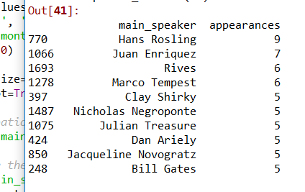
TED Talk Speakers and their occupations:
From the screenshot you can observe that Hans Rosling made maximum number of appearances in TED Talks i.e.9 .
Screenshot shows us the 10 speakers with maximum appearances.

Slide 14
TED Talk Speakers and their occupations:
TED Talk speakers come from various backgrounds. So what is the occupation of these speakers?
We observe that writer is the most popular occupation and then Artist and Designer.
But as speakers may identify themselves in multiple professions we should not consider this graph in screenshot as 100% accurate.
(Note: Graph is in next slide)

Slide 15
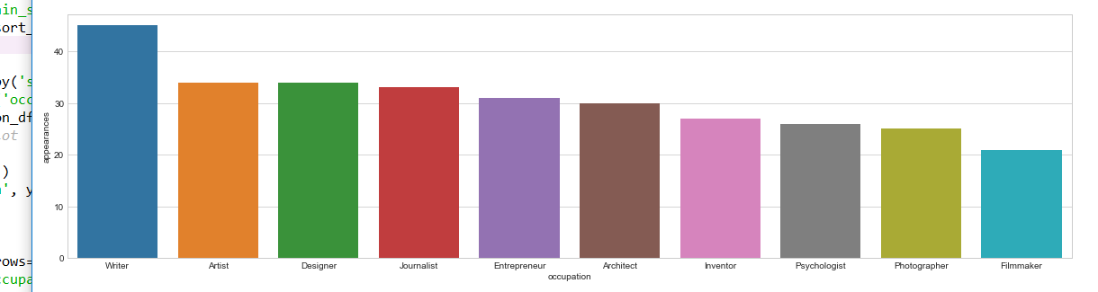
TED Talk Speakers and their occupations:

Slide 16
Number of views attracted by profession of the speakers in a boxplot
Screenshot in the next slide shows the top 10 most popular professions and views.
Psychologists gather the highest views by median value. Writers have the greatest range of views between Q1 and Q3.

Slide 17
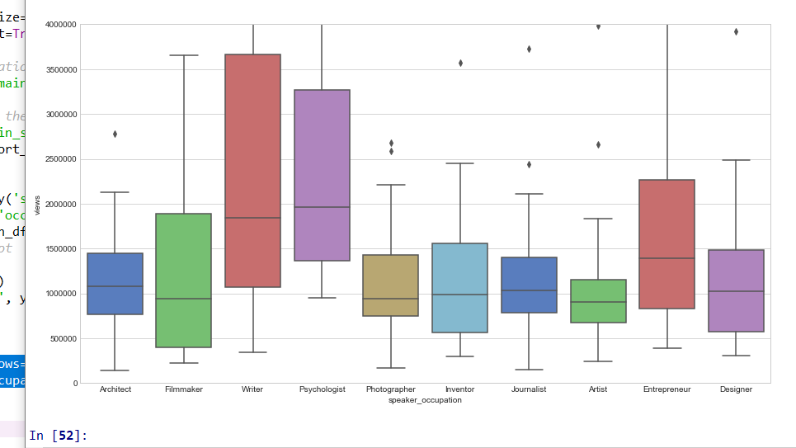
Boxplot of Speaker’s occupation Vs views

Slide 18
K Means Clustering
I applied Kmeans Clustering on “Views and Comments” and also on “Views and Duration”
I decided to select views and comments variable since they had some correlation between them (Ref: slide 9)
Screenshot in the next slide gives an idea of “Views and Comments”.
Three clusters were created which are following:
Low views
Medium views and
High views
From the screenshot it is clear that there are few TED Talks which have low views but comments by viewers are high.
At the same time TED Talks with high views (in high view cluster in pink color) there are talks with few comments
Code: #Cluster 1 "View and Comments"
df_combined = df[['views', 'comments']]
df_combined
kmeans = KMeans(n_clusters=3)
kmeans.fit(df_combined)
y_pred = kmeans.predict(df_combined)
centroids = kmeans.cluster_centers_
fig = plt.figure(figsize=(10,10))
plt.scatter(df_combined['views'], df_combined['comments'], c=y_pred, alpha=0.5)
plt.show()

Slide 19
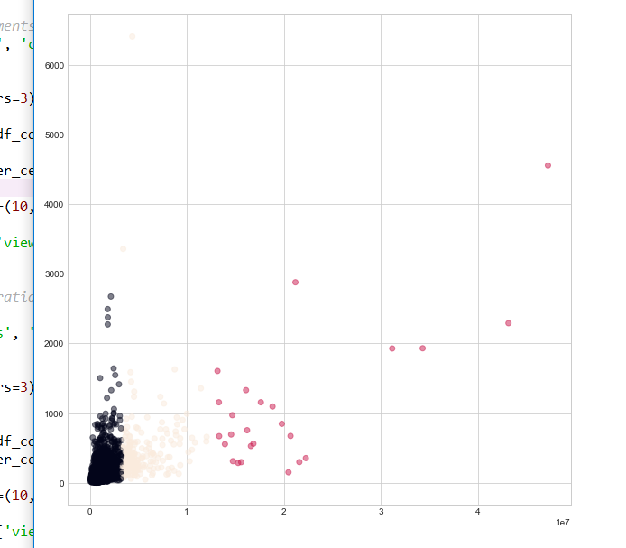
K Means Clustering

Slide 20
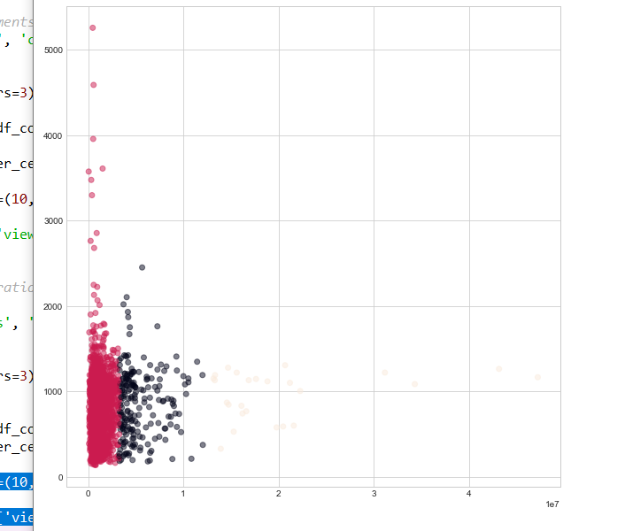
K Means Clustering
Second clustering is between “Views and Duration”
Note: third cluster is very light color and is next to second cluster in black color

Slide 21
TED Talks Themes:
TED talks was started out as a conference about technology, entertainment and design, it has till now diversified into virtually every field of study and walk of life.
len(theme_df['theme'].value_counts())
Output: 416
TED defines a surprising 416 different categories for its talks.
Most popular theme for talks still is technology and second is science.

Slide 22
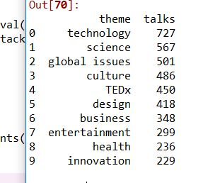
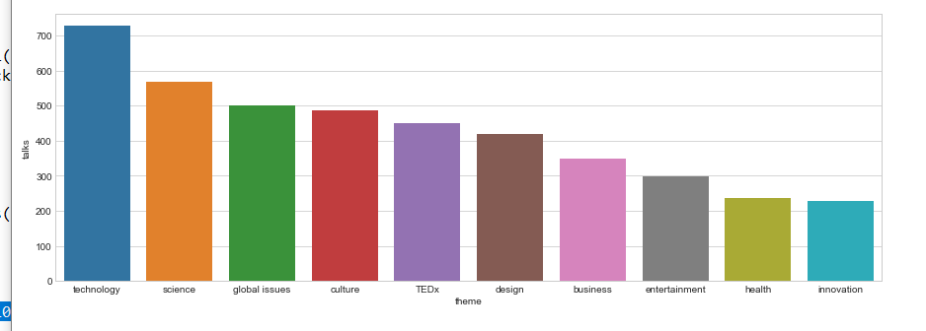
Is TED Talks conference bias towards any particular theme?
Most popular theme for talks still is technology and second is science.
From the screenshots it is clear that TED Talks are not biased towards any particular theme

Slide 23
CONCLUSION
From the above analysis and clustering a individual can give an estimate about how many views will a speaker get if his occupation is Writer or Architect.
A individual can also estimate most popular talks, talks with most comments, how many TED talks have been organized over the years (i.e. 1972-2017).
From the analysis we now know how many TED Talks have been organized till 21st September 2017, which speaker has highest appearances in TED Events.
I would end my analysis here.
Naturally, with TED Talks dataset I believe one can come up with many more meaningful insights.

